Slide 1
Predicting Movie Success
Fenil Vora

Slide 2
Agenda
1. Introduction
1. Project Goal
2. Project Benefits
2. Data Exploration
1. Importing Dataset and Libraries
2. Categorizing the Target Variables
3. Handling Missing Values
4. Label Encoding
5. Correlation
3. Classification Model Building
1. Train Test Split
2. Scaling
3. Feature Selection using RFECV
4. Random Forest
5. Confusion Matrix
6. Classification Report

Slide 3
Methodology
Load and explore the dataset using pandas, matplotlib, and seaborn.
Preprocess the data, including handling missing values, label encoding, and addressing multicollinearity.
Implement feature selection.
Split the data into training and testing sets, and apply feature scaling.
Train and evaluate a Random Forest classifier for predicting movie success categories.
Generate and interpret performance metrics and visualizations.

Slide 4
1. Introduction
The movie industry is highly competitive, and predicting a film’s success is a major challenge due to the many factors that influence its performance, such as genre, cast, budget, and marketing. This project aims to develop a predictive model to forecast a movie's potential success after its release.
By analyzing historical data, we seek to identify key factors that contribute to box office performance and audience reception. The benefits of this model include more informed investment decisions, targeted marketing strategies, better talent selection, and reduced financial risk for stakeholders in the film industry.

Slide 5
1. Project Goal :
To develop a comprehensive data analysis pipeline and a robust machine learning model to accurately predict movie success categories (Hit, Average, Flop) based on various movie attributes. By utilizing this model, the studio aims to improve movie production decisions, marketing strategies, and overall film industry insights.

Slide 6
2. Project Benefits :
Production Optimization: The model will help identify factors influencing movie success, allowing for more informed decisions in movie production.
Marketing Strategy: Accurate prediction of movie success can assist in tailoring marketing efforts and budget allocation.
Industry Insights: Understanding success patterns can guide future trends and innovations in filmmaking.

Slide 7
2. Data Exploration (Exploratory Data Analysis)
Step-1 : Data Collection
Step-2 : Data Exploration
Step-3 : Categorizing the target variables
Step-4 : Handling the missing values

Slide 8
1. Importing the Dataset and Libraries :
Importing all the required libraries for preprocessing i.e. pandas, NumPy, seaborn and matplotlib. Importing the dataset given by the client to the notebook using ‘pd.read_csv’ function from pandas library.
After importing the dataset we check the shape and the description of the dataset.
The original dataset has 5043 rows and 28 columns.
Check the data type of each column.
Datatypes: float64(13), int64(3), object(12)
We check if there are any null cells in the dataset.

Slide 9
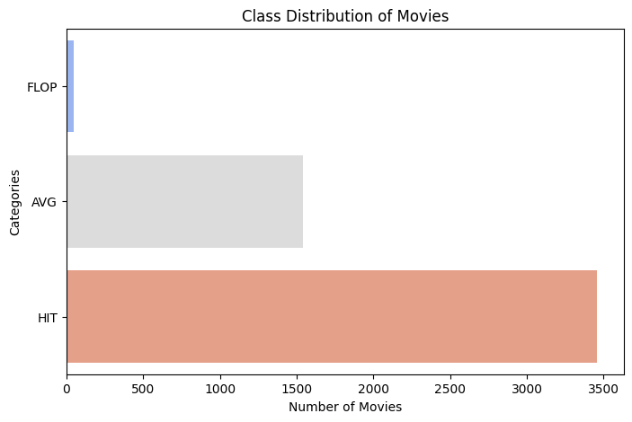
2. Categorizing the Target Variables :
Creating a new column ‘box_office_status’ to categorize movies into "Hit", "Average", or "Flop" based on the IMDB score ranges(|1-3 | -Flop Movie , |3-6 |- Average Movie,|6-10 |- Hit Movie)
As seen in the graph there are more number of hit movies.
3. Handling Missing Values :
Dropping the samples which have missing values.
After dropping all the samples which have missing values we are left with a clean data which has 3755 rows and 29 columns.
No column has been dropped.
We save the clean data as a separate csv file for making a dashboard.

Slide 10
4. Label encoding :
All the categorical columns are label encoded in this step.
5. Correlation :
We have to find out if there is any relation between the columns. Multicollinearity cause errors to the prediction. Hence, we remove any multicollinearity. We also remove the column ‘imdb_score’ since we already have a column ‘box_office_status’.

Slide 11
3. Classification Model Building
Classification is a supervised machine learning method where the model tries to predict the correct label of a given input data. In classification, the model is fully trained using the training data, and then it is evaluated on test data before being used to perform prediction on new unseen data.
Splitting the data into X and y where X contains independent variables and y contain Target/Dependent variable.

Slide 12
Train Test Split :
We need data not only to train our model but also to test our model. So splitting the dataset into 70:30 (Train: Test) ratio. We have a predefined a function in Sklearn library called train_test_split, we use that.
2. Scaling :
Few variables will be in the range of Millions and some in Tens, lets bring all of them into same scale.

Slide 13
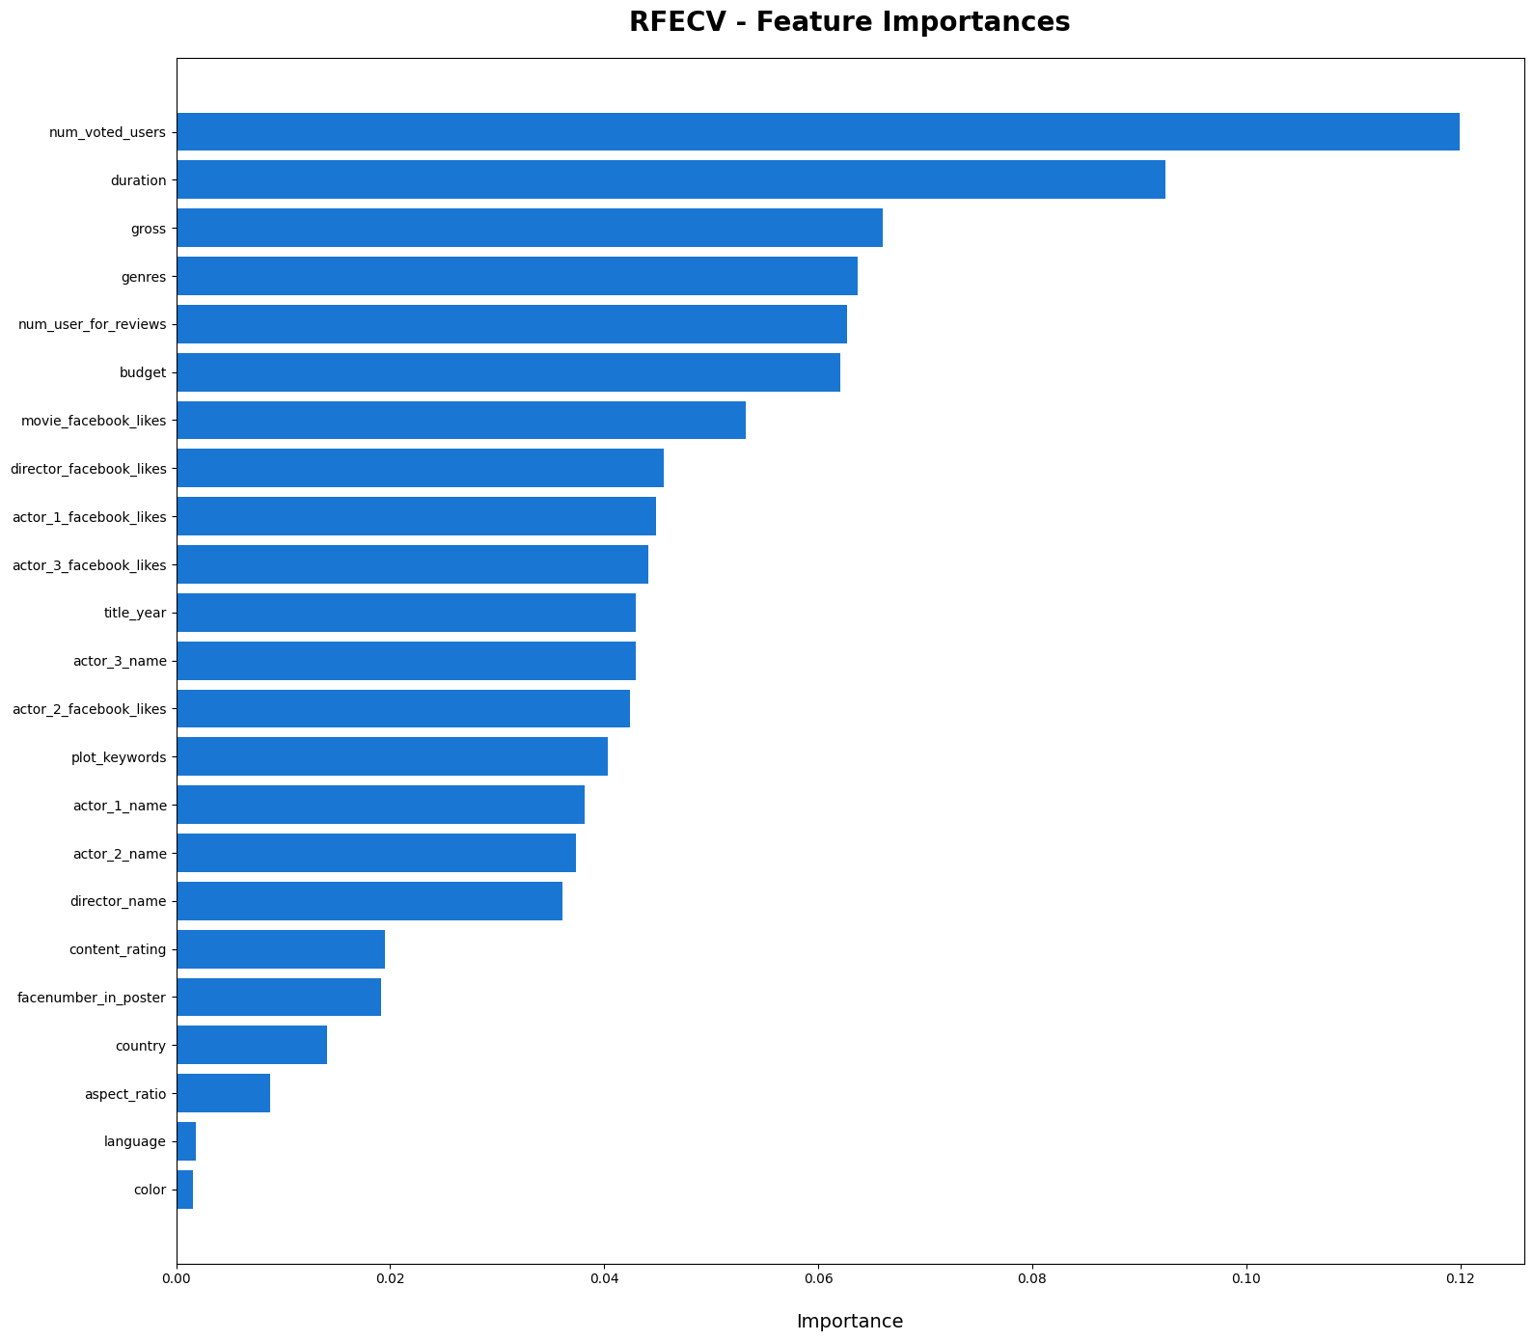
3. Feature Selection using RFECV :

Slide 14
4. Random Forest :
Random Forest is a classifier that contains a number of decision trees on various subsets of the given dataset and takes the average to improve the predictive accuracy of that dataset.
5. Confusion Matrix :
A confusion matrix is a matrix that summarizes the performance of a machine learning model on a set of test data. It is a means of displaying the number of accurate and inaccurate instances based on the model’s predictions. It is often used to measure the performance of classification models, which aim to predict a categorical label for each input instance.

Slide 15
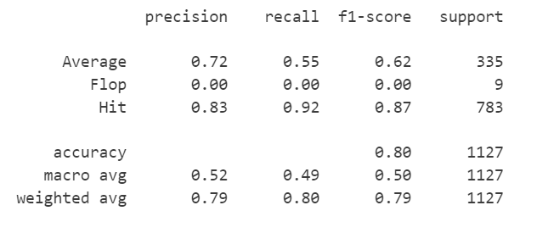
6. Classification Report :
As seen in the classification report. We have an accuracy of 80% for this model.

Slide 16
Questions ?

Slide 17
Thank You!

